Slide 1
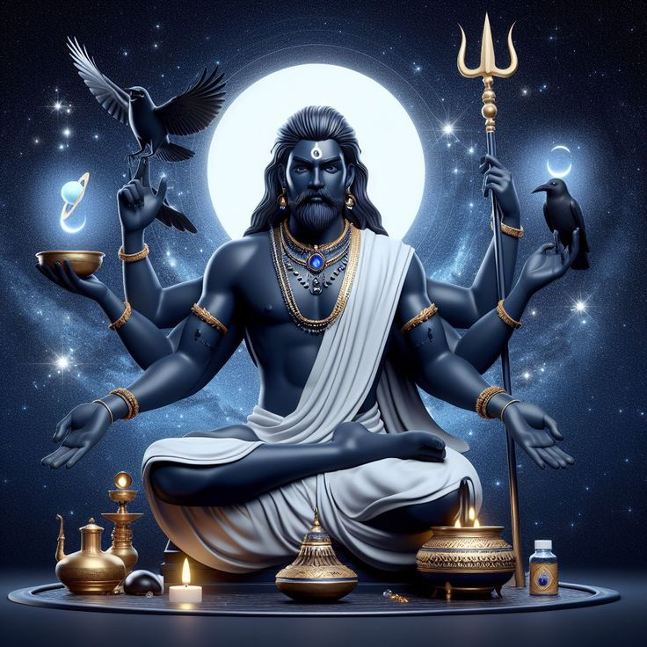
Shani: Apna Vakeel khud baniye

Slide 2
PROBLEM STATEMENT
As we all know that many of us do not know about the constitution of India as well as the rights of the people specified in our constitution which leads to people getting stuck in various legal problems.
For example:
Many teenage girls get blackmailed by people who blackmail by saying that they would leak explicit photos and videos of the girl and also demand for money. Moreover, most families end up giving the money as they are unaware of their basic constitution rights.
Sometimes when the traffic police stops us, the police takes the keys out of our vehicle and many of us do not know what to do in that situation,

Slide 3
Solution
So the solution we bring up for this problem is:
Shani: apna vakeel khud baniye, which is a law based chatbot or a chatbot lawyer which is capable of giving legal advices to the people when they need it the most.
Our chatbot uses technologies like React anfd Nodejs for building the chatbot interface and a chatbot model built using ML and AI and trained using the sections and articles of the constitution of India
This can be a great help to people when they are stuck in legal situations and can then take legal advice through our chatbot.
Our chatbot’s main motive is to make make the public legally aware about their rights and that too very easily and conveniently(while sitting at your home).

Slide 4
Details of our system
Our system utilizes:
Feed Forward Neural Network which has been implemented in Python using the PyTorch library.
Our system utilizes NumPy library of Python for handling N-Dimensional array
Our system utilizes the Flask app for integrating React and python programs.
Our system uses React for designing the front-end and the chatbot interface

Slide 5
PROTOTYPE AND IMPLEMENTATION OF THE PROJECT

Slide 6
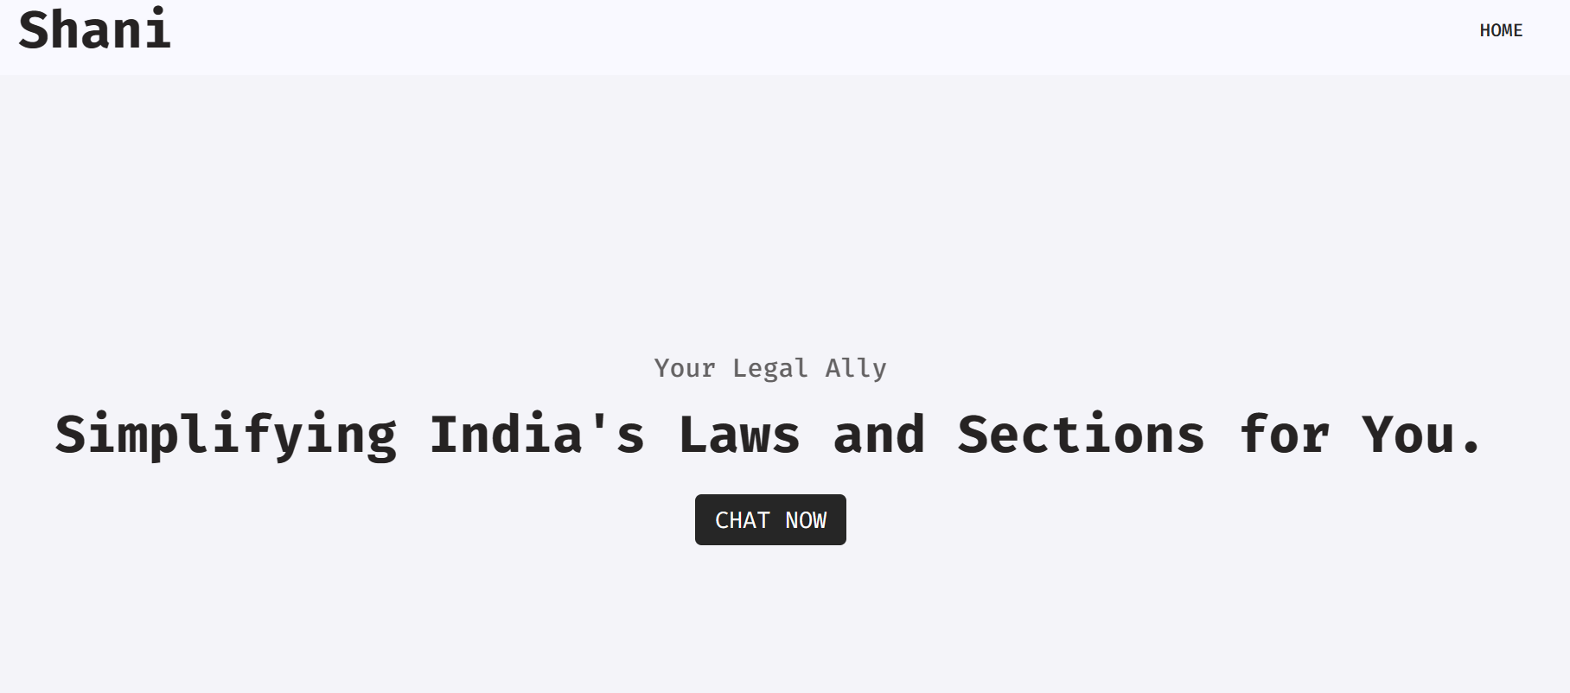
Interface built using React:

Slide 7
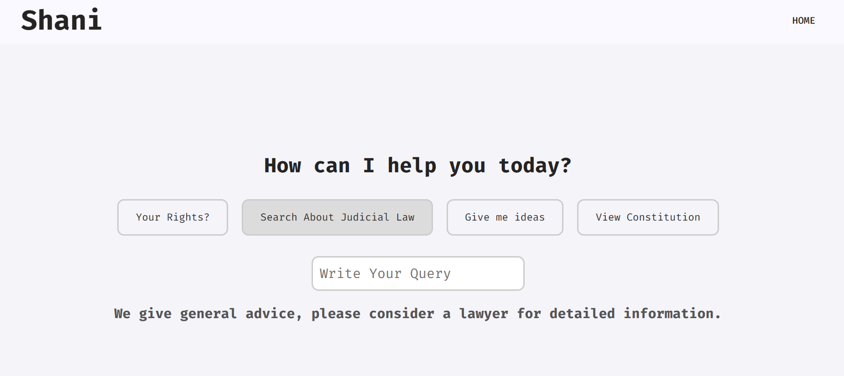

Slide 8
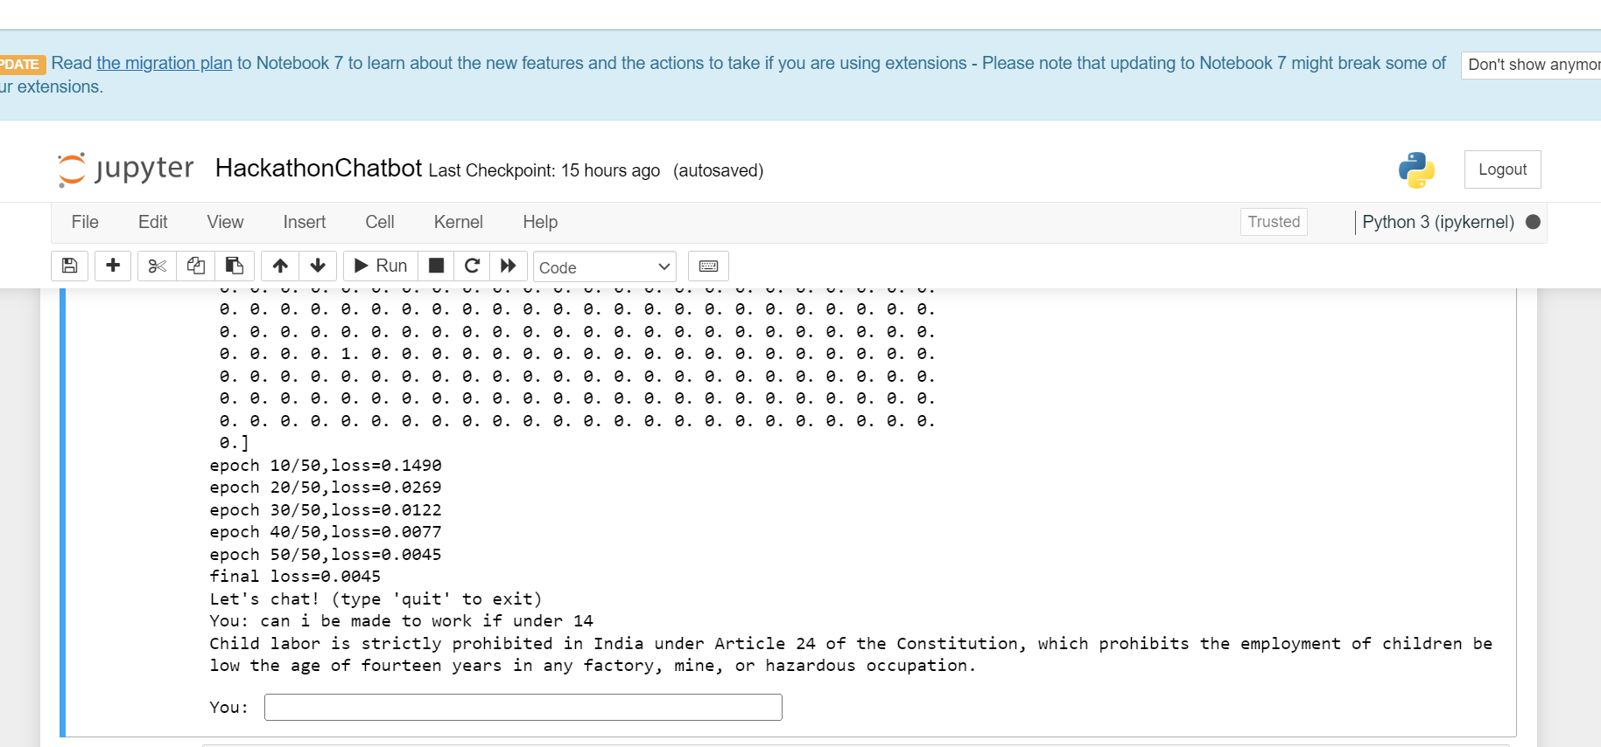
Chatbot Logic using Python :

Slide 9
So this was the implementation of our React front-end interface for the chatbot and the working of the chatbot in Python.
Right now this is an implementation of how things are going to be in our chatbot and we are working on the project to integrate the front end as well as Backend using Flask of Python and we are also improving the chatbot performance and accuracy by regularly updating and optimizing our model to reach our objective of deploying our project on a large scale and reach as many people as possible and be of some help to them

